Slide 1

TIER-Plus: Supporting evidence-informed prioritization and trade-off analysis in HIV service planning
HIV service delivery prioritization in resource-constrained settings
Brooke Nichols, Boston University
18 August 2026

Slide 2
Who is TIER-Plus for?

Slide 3

Let’s take a look
ORIENTATION
INPUTS (country & coverage)
SCENARIOS (adjust interventions)
4. OUTPUTS (costs + outcomes + cascades)

Slide 4
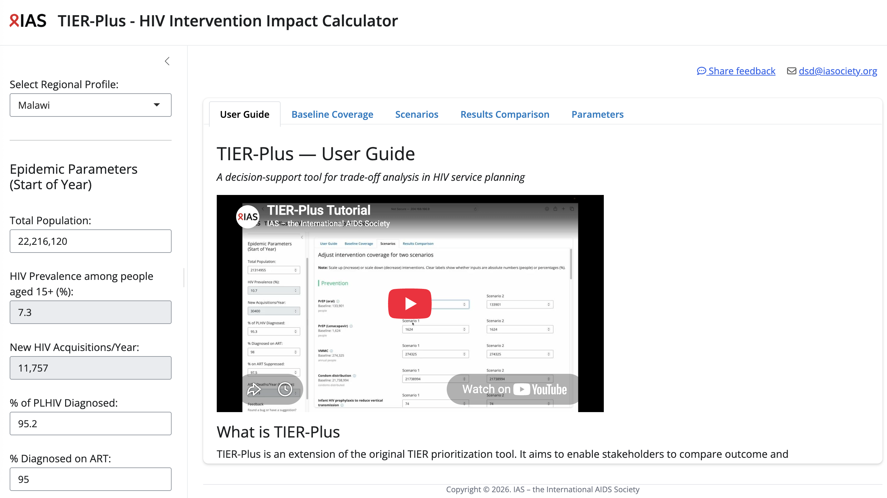
Orientation

Slide 5
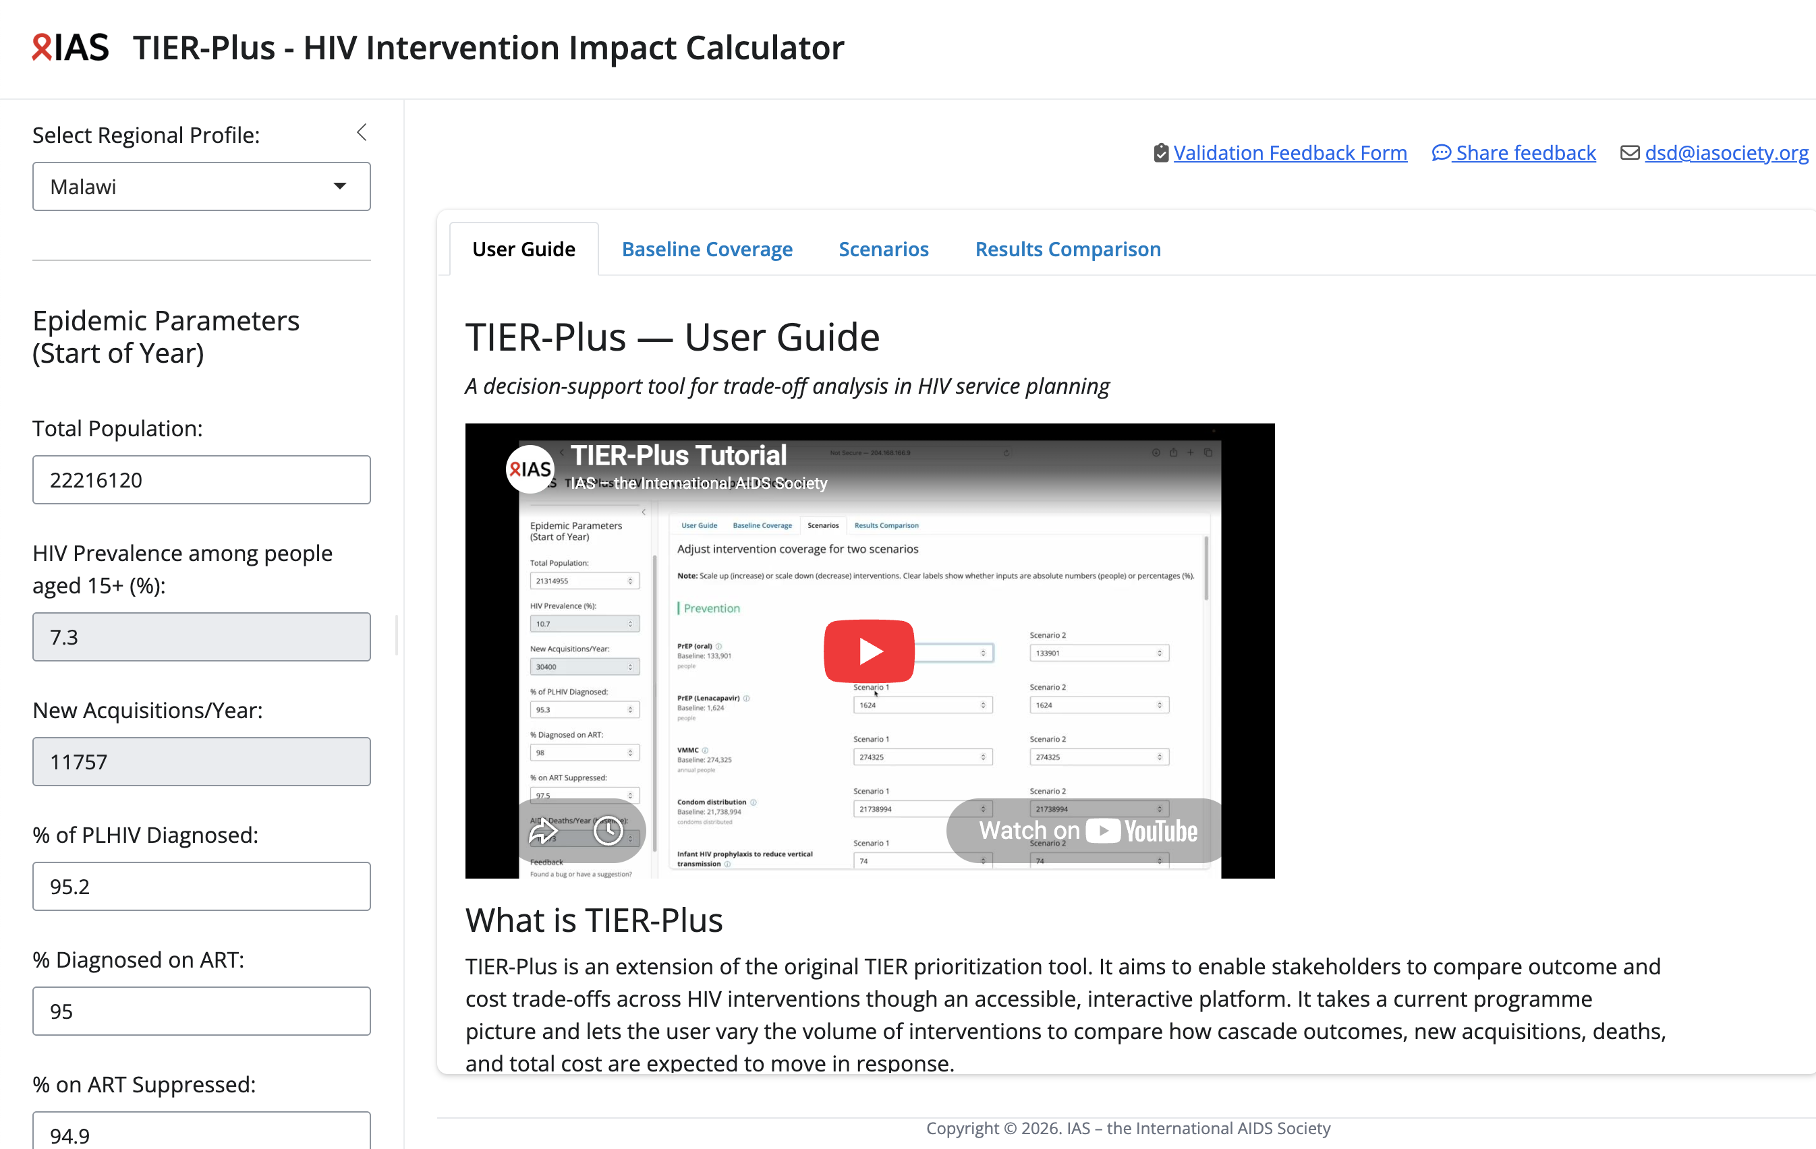
What goes in (inputs 1)
Select the country
Confirm (or edit) epidemic parameters (greyed out cannot be modified)

Slide 7
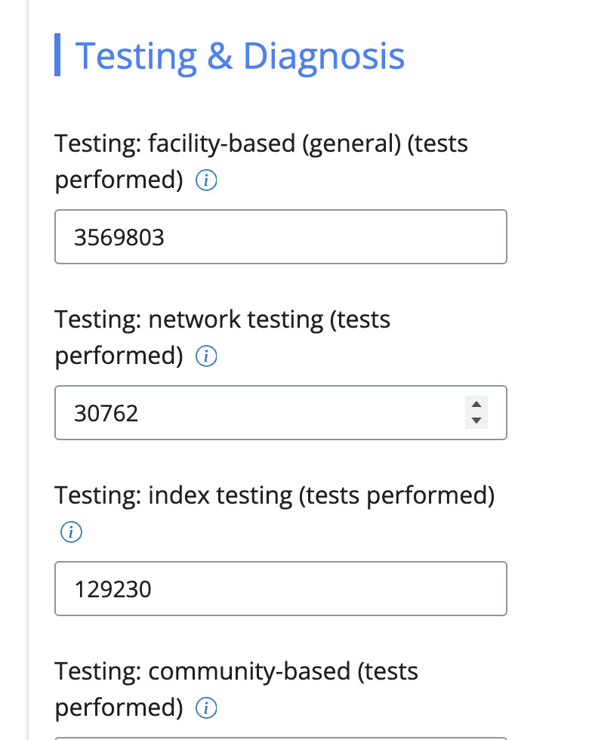
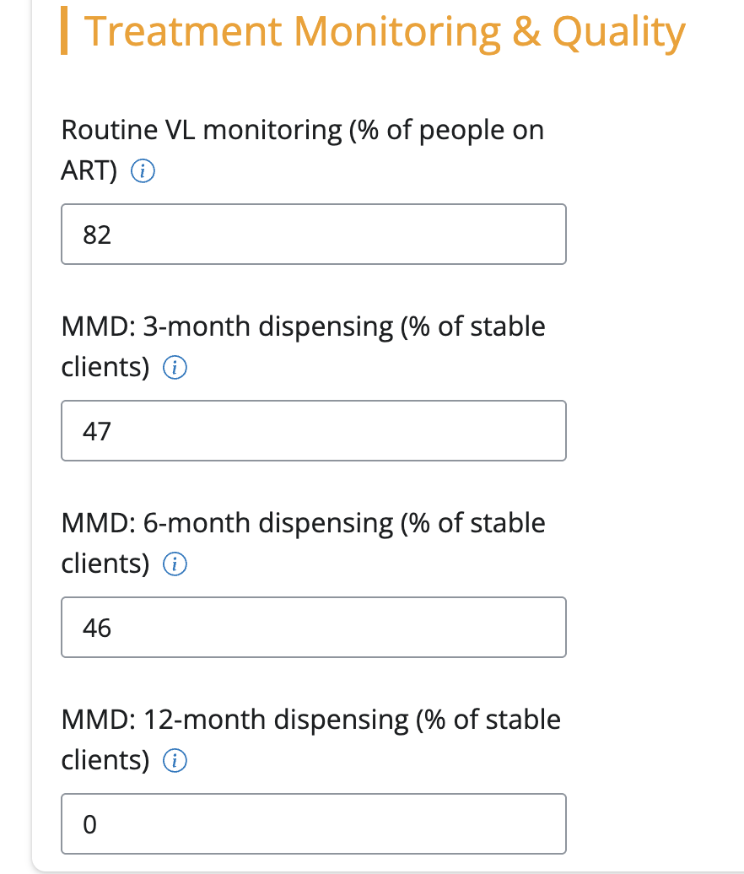
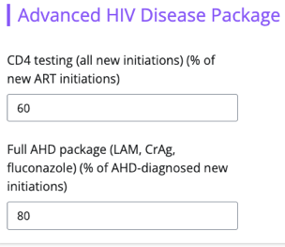
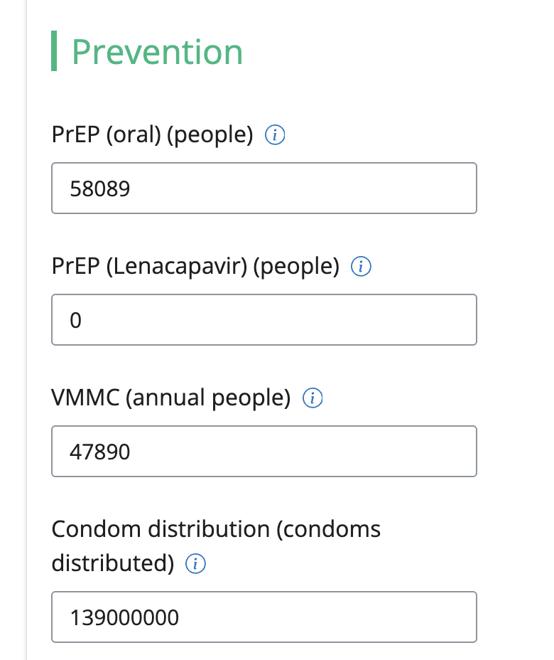
What goes in (inputs 2)
c. Baseline interventions (coverage)
For prevention
For testing and diagnosis
For treatment monitoring and quality
For retention and adherence support
For advanced HIV disease
Important note!
Default data is provided → Users can customize if better national data are available.

Slide 8
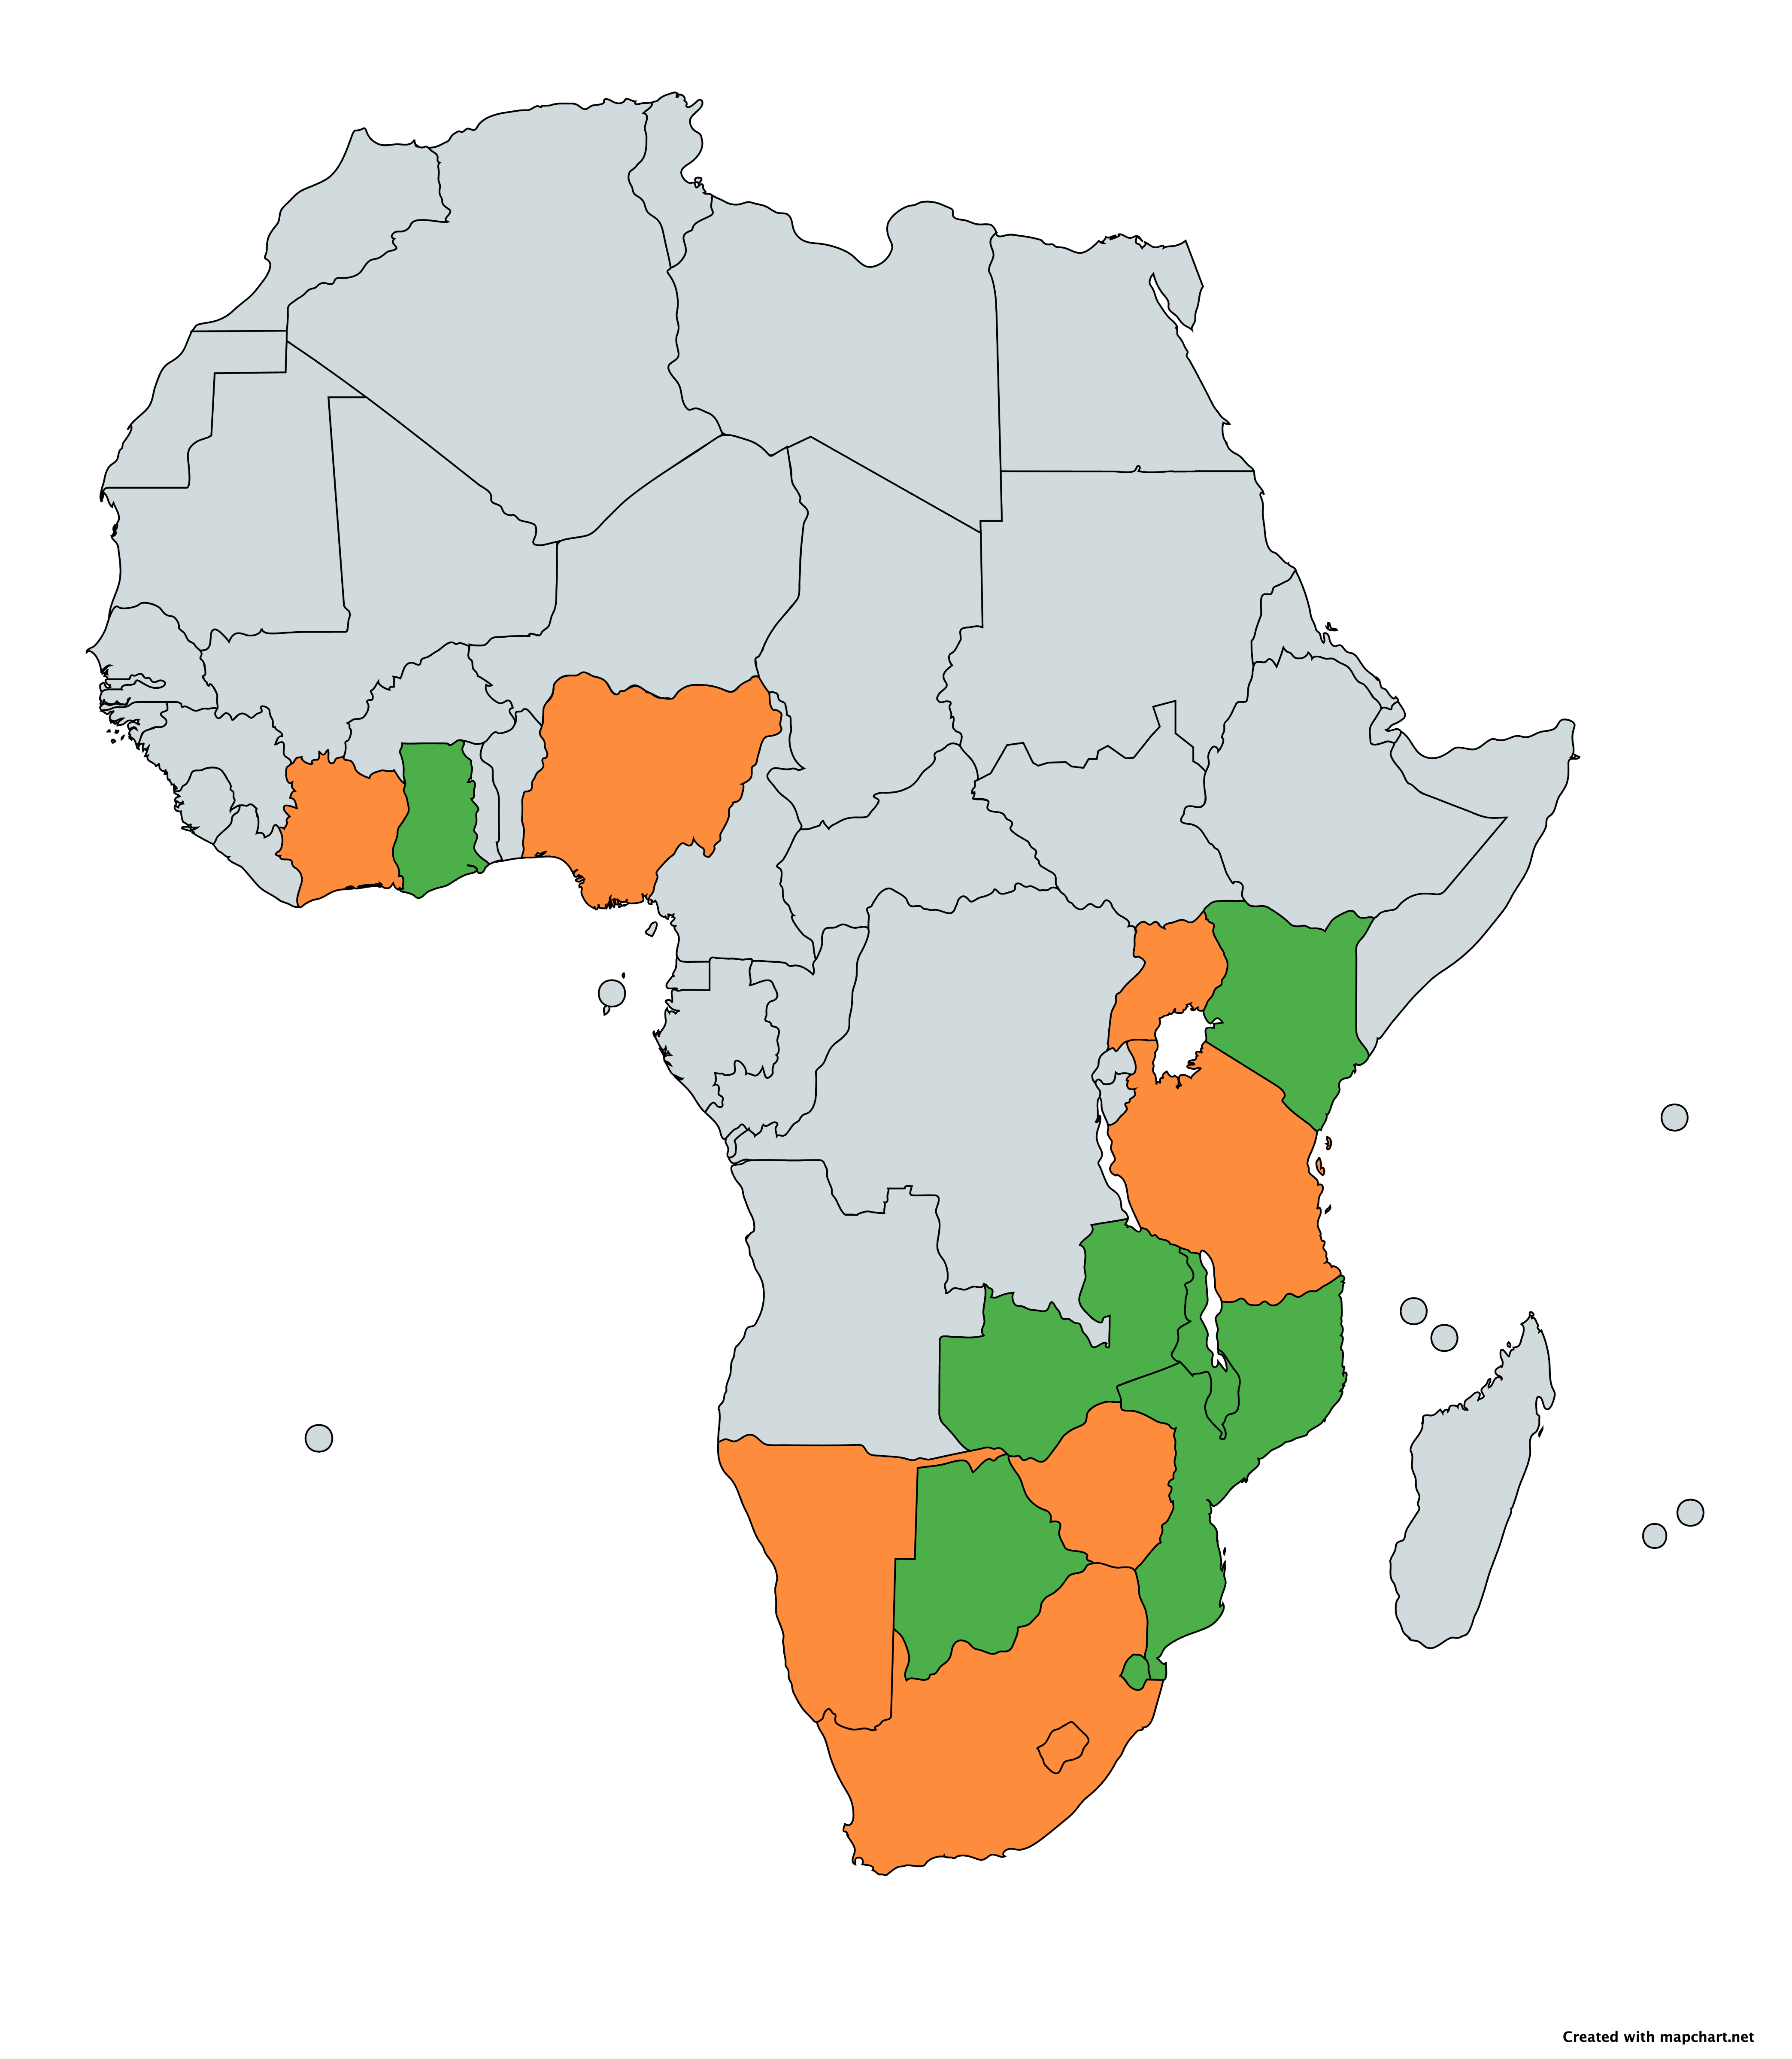
Countries represented in TIER-Plus
Uganda
Baseline data values reviewed and updated by in-country teams
Baseline data values from publicly available resources and literature
Côte d’Ivoire
Ghana
Nigeria
Kenya
Tanzania
Malawi
Zambia
Namibia
Mozambique
Zimbabwe
South Africa
Eswatini
Lesotho

Slide 10

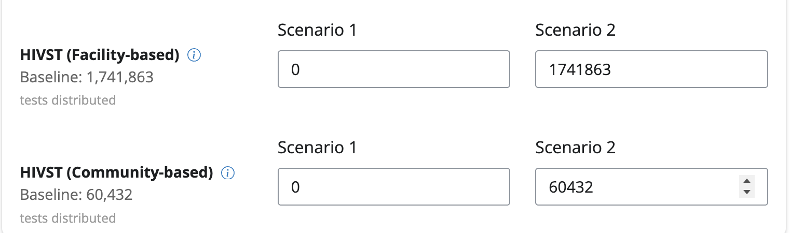
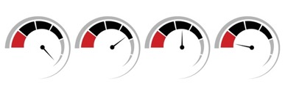
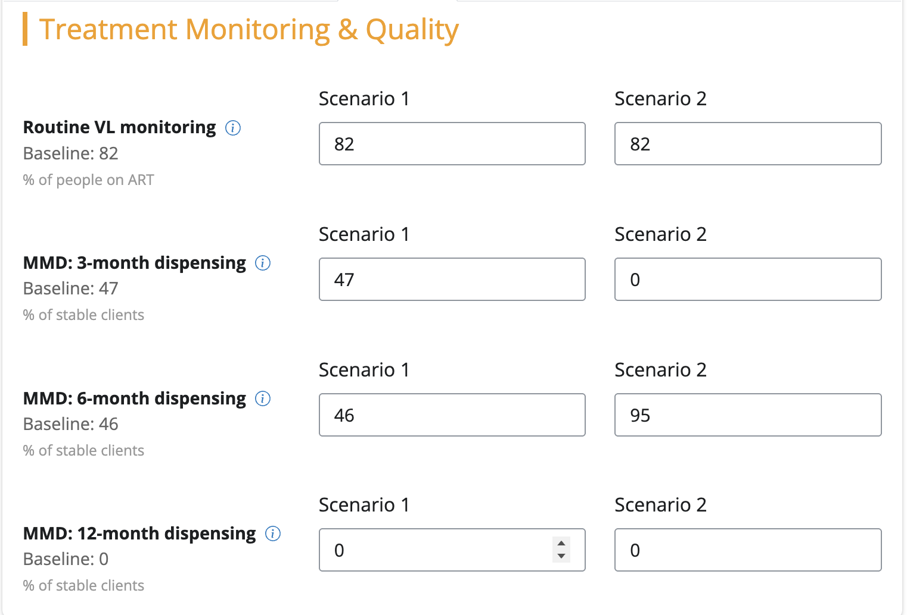
Then it’s time to play –
or build scenarios
For example:
Scenario 1: No self-testing
Scenario 2: more 6MMD
Adapt the coverage of different interventions (populate different scenarios for comparison)
Add more interventions, and/or take some away
With this information, more and less of different interventions, TIER-Plus can then compare the impact on costs and outcomes

Slide 12
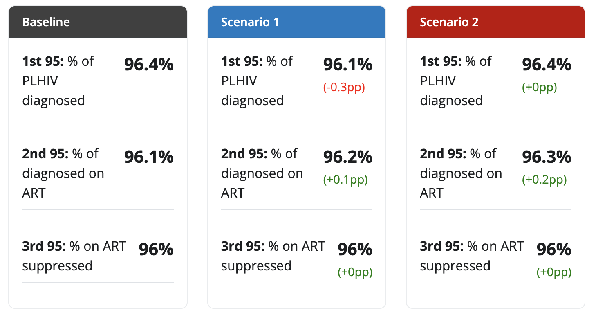
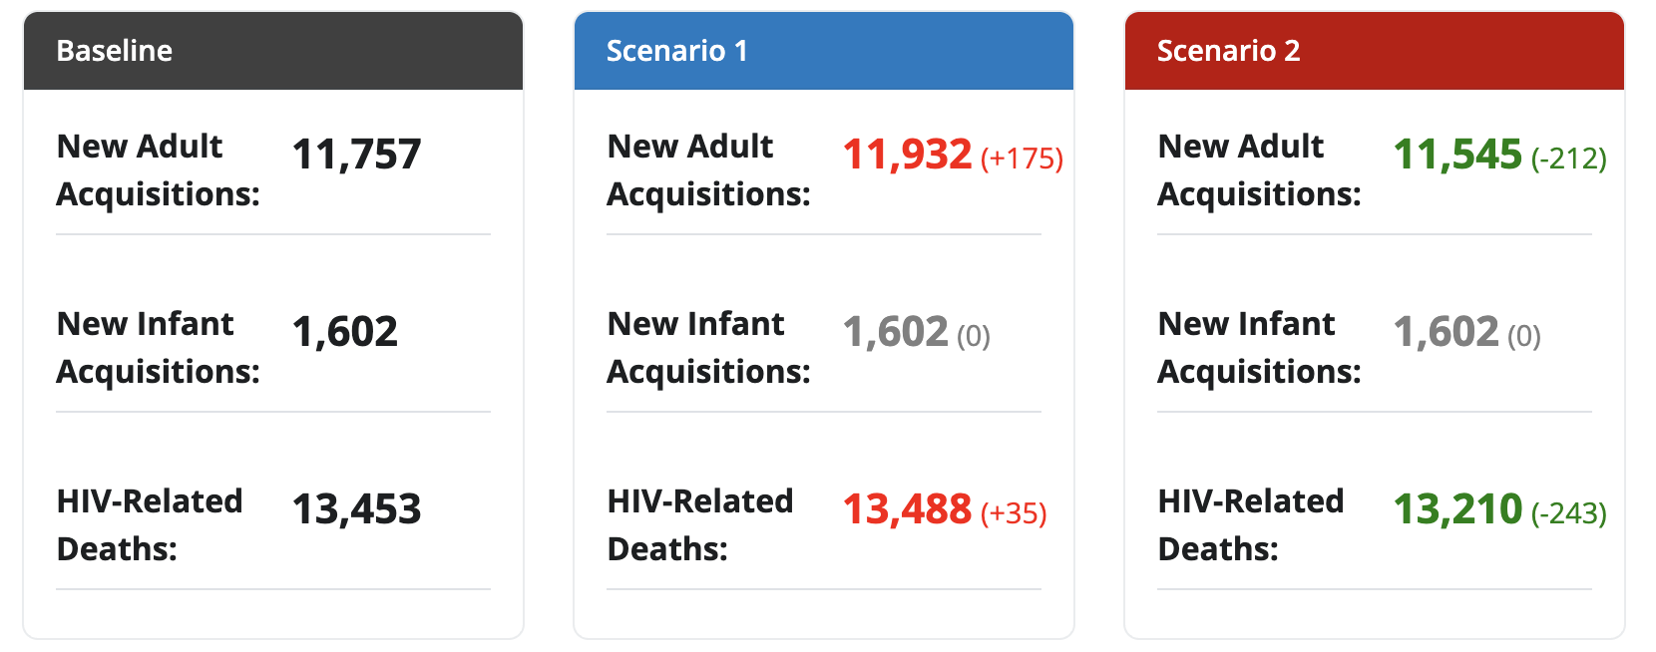
What TIER-Plus produces (outputs) 1/3
→ Two scenarios compared to the baseline
1-year outputs
a. Progress towards 95-95-95s
b. Key epidemiological outcomes

Slide 13
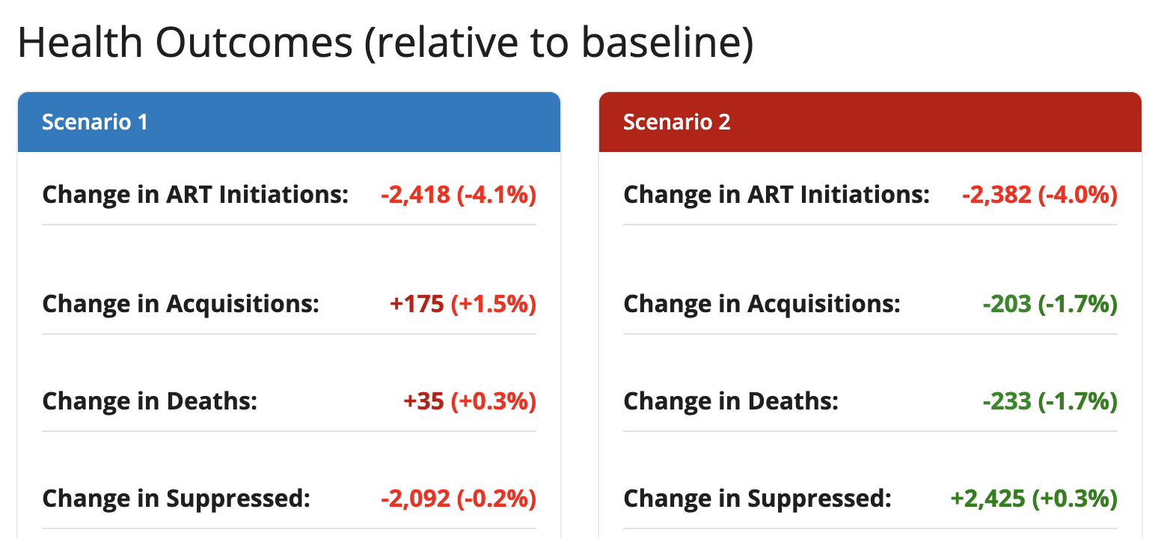
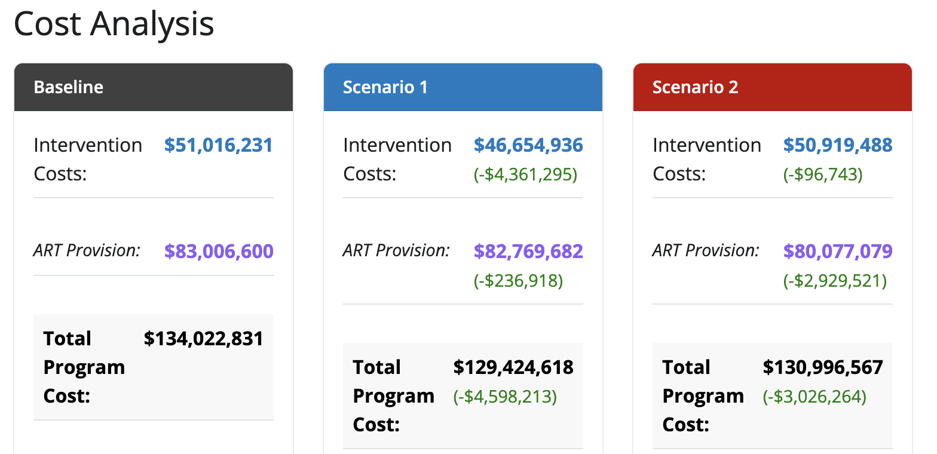
What TIER-Plus produces (outputs) 2/3
c. Health outcomes
d. Cost analysis

Slide 14
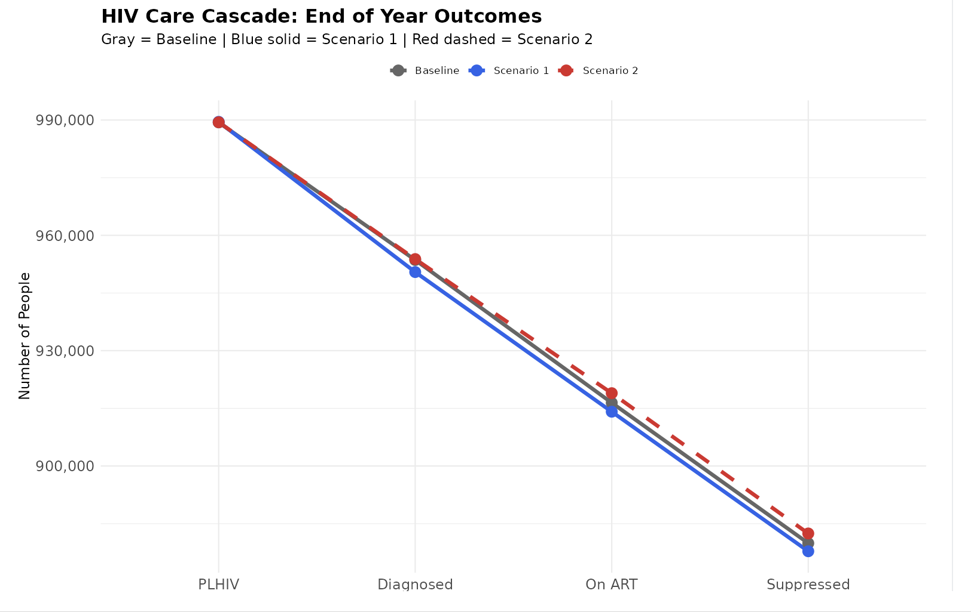
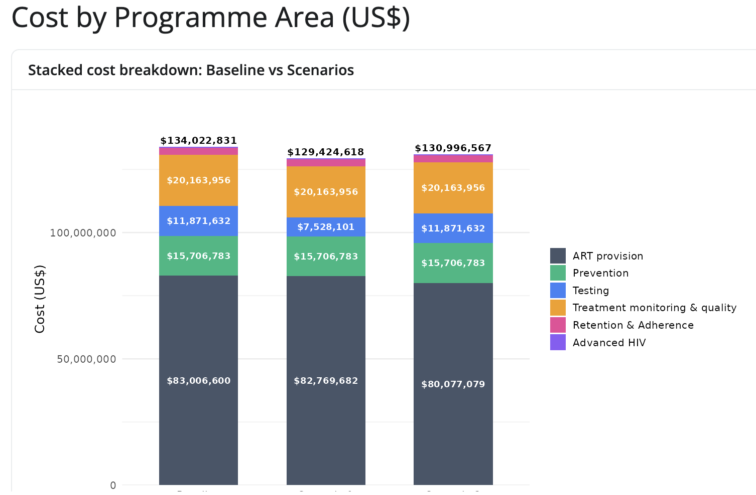
What TIER-Plus produces (outputs) 3/3
e. Impact on HIV care cascade
f. Cost breakdown

Slide 16
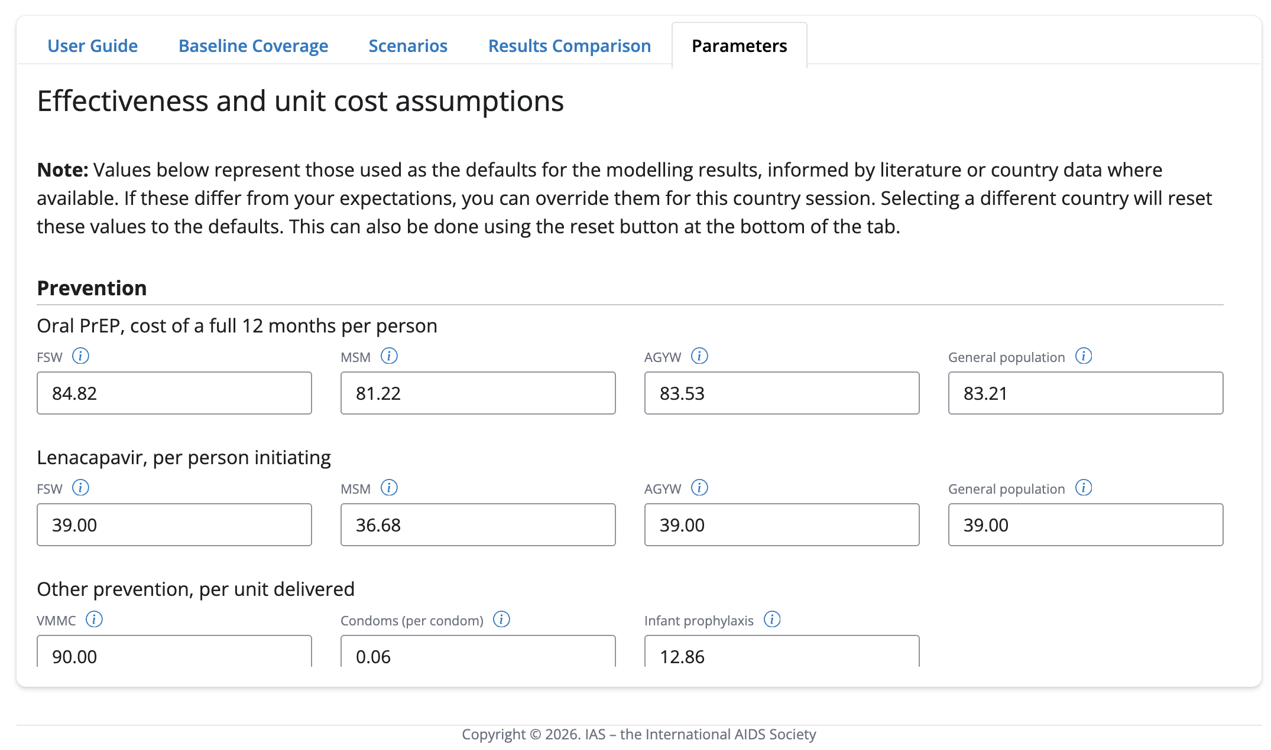
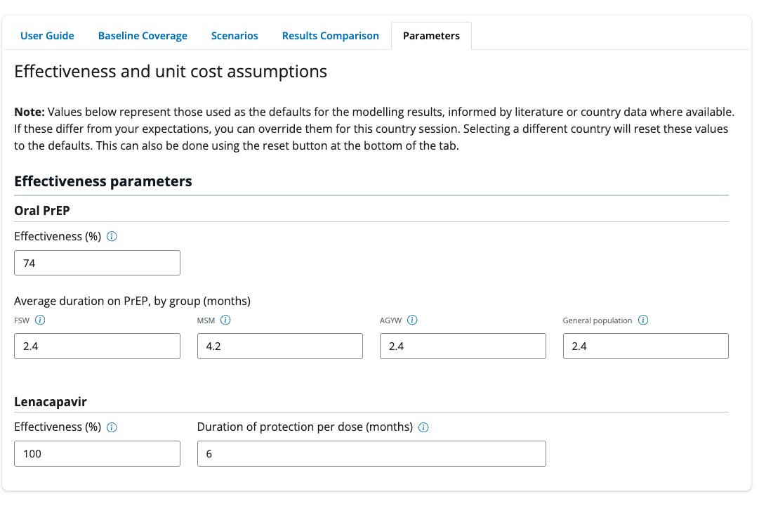
What if you want to adjust the assumptions?

Slide 17
What TIER-Plus can and cannot do
✅ What TIER-Plus can do
❌ What TIER-Plus cannot do
✅ Support decision making conversations at a national level
✅ Look at the impact across the cascade of multiple interventions
✅ Give an understanding of relative impact of different interventions on both outcomes and cost
❌ Provide exact cost estimates for budgeting
❌ Give long-term estimates on epidemic impact
❌ Replace intervention-specific planning (use DMPPT, PrEP-it, etc.)
❌ INTEGRATION

Slide 18
The piloting phase
The piloting phase has resulted in several meaningful changes:
Feedback | Completed
PrEP targeting by sub-population | ✔️
Updated costs | ✔️
Output including cost breakdown by category of costs | ✔️
Inclusion of 6-monthly clinical visits vs 12- monthly clinical visits | ✔️
Model display improvements | ✔️
Updated costs | ✔️
Users able to update parameters | ✔️
Adding additional countries
PrEP targeting to pregnant and breastfeeding women
Further results functionality
Changes to VL algorithm
~
~
~
~

Slide 19
TIER-Plus is a living tool
We need and want your feedback to make TIER-plus as useful as possible!
What else would you like to see?
Please explore and provide feedback!

Slide 20
Thank you

